Slide 1

https://sahibulsaif.wordpress.com/wisdom/bismillah-nature/

Slide 2
EER Modeling
CSC271 – DATABASE SYSTEMS

Slide 3
Previous Lecture Overview

Slide 4
Today’s Lecture
In this lecture, you will learn the following aspects of ER Model:
Specialization
Generalization
Constraints
Type Discriminators

Slide 5
Specialization
Specialization is the process of defining a set of subclasses of an entity type
The set of subclasses is based upon some distinguishing characteristics of the entities in the superclass

Slide 6
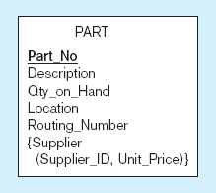
Specialization
Only applies to manufactured parts
Only applies to purchased parts

Slide 7
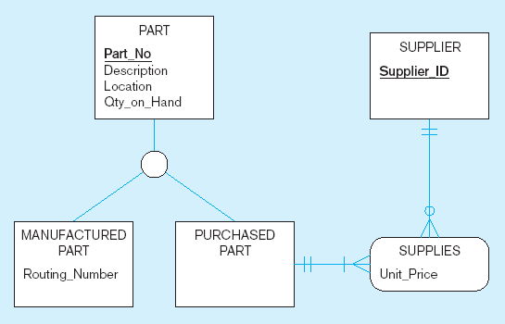
Specialization : Example
Specialization to MANUFACTURED PART and PURCHASED PART
Created 2 subtypes
Note: multivalued attribute was replaced by an associative entity relationship to another entity

Slide 8
Specialization
Two major reasons for including class/subclass relationship and specialization in a data model:
Certain attributes may apply to some but not all entities of the superclass
Some relationship types may be participated in only by entities that are members of the subclass

Slide 9
Specialization
In summary, the specialization process allows us to do the following:
Define a set of subclass of an entity type
Establish additional specific attributes with each subclass
Establish additional specific relationship types between each subclass and other entity types or other subclasses

Slide 10
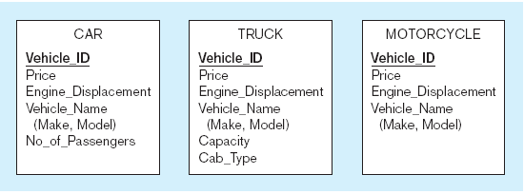
Generalization
The process of defining a more general entity type from a set of more specialized entity types. BOTTOM-UP
All these types of vehicles have common attributes

Slide 11
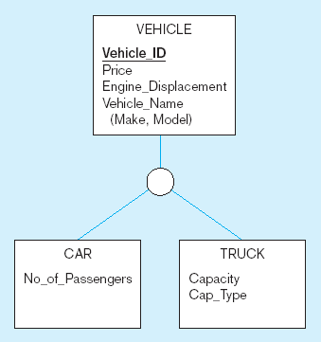
Generalization : Example
So we put the shared attributes in a supertype
Note: no subtype for motorcycle, since it has no unique attributes

Slide 12
EER Constraints : Completeness Constraint
Completeness Constraints: Whether an instance of a Supertype must also be a member of at least one subtype
Total Specialization Rule: Yes (double line)
Partial Specialization Rule: No (single line)

Slide 13
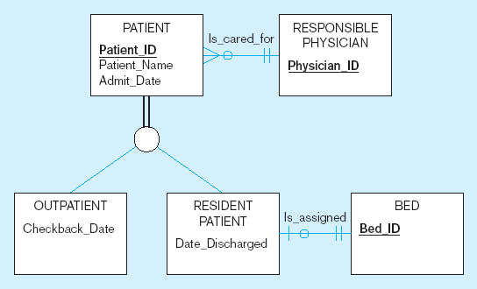
Examples of completeness constraints
Total specialization rule
A patient must be either an outpatient or a resident patient

Slide 14
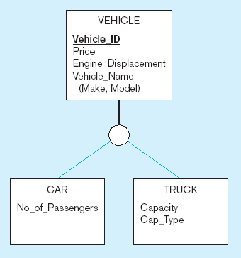
Examples of completeness constraints (cont.)
A vehicle could be a car, a truck, or neither
Partial specialization rule

Slide 15
EER Constraints : Disjointness Constraint
Disjointness Constraints: Whether an instance of a Supertype may simultaneously be a member of two (or more) subtypes
Disjoint Rule: An instance of the Supertype can be only ONE of the subtypes
Overlap Rule: An instance of the Supertype could be more than one of the subtypes

Slide 16
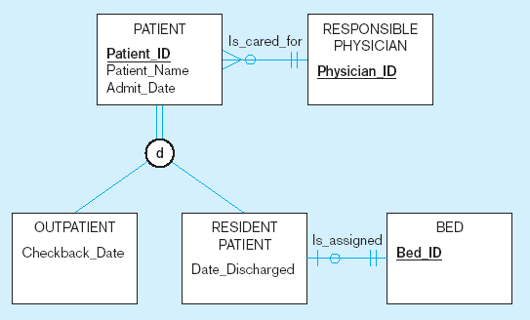
DISJOINTNESS CONSTRAINT : EXAMPLE
Disjoint rule
A patient can either be outpatient or resident, but not both

Slide 17
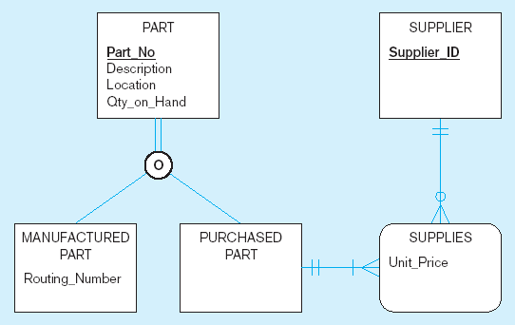
DISJOINTNESS CONSTRAINT : EXAMPLE
b) Overlap rule
A part may be both purchased and manufactured

Slide 18
EER Constraints : Discriminators
Subtype Discriminator: An attribute of the Supertype whose values determine the target subtype(s)
Disjoint – a simple attribute with alternative values to indicate the possible subtypes
Overlapping – a composite attribute whose subparts pertain to different subtypes. Each subpart contains a Boolean value to indicate whether or not the instance belongs to the associated subtype

Slide 19
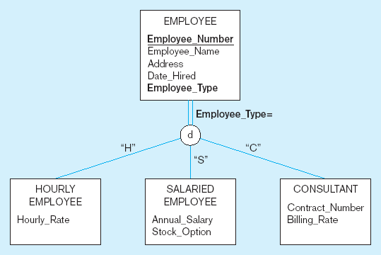
Introducing a subtype discriminator (disjoint rule)
A simple attribute with different possible values indicating the subtype

Slide 20
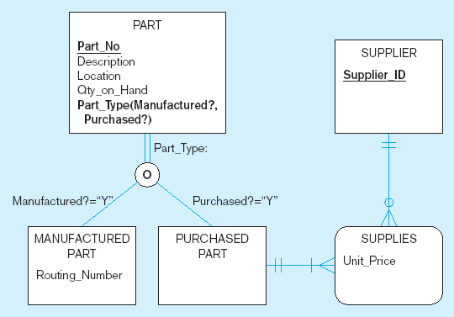
Subtype discriminator (overlap rule)
A composite attribute with sub-attributes indicating “yes” or “no” to determine whether it is of each subtype

Slide 21
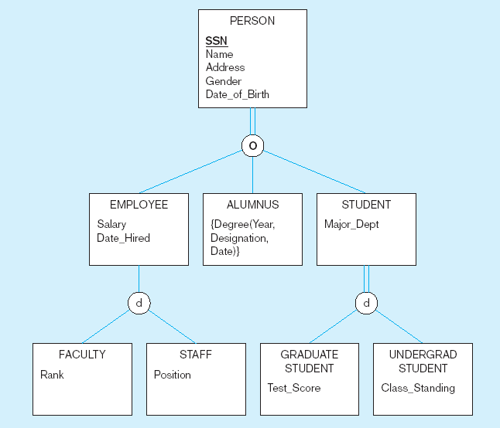
Example of Supertype / Subtype hierarchy

Slide 22

http://www.thomasformo.com/category/qa/

